Slide 1


Predicting Hotel Booking Cancellations
Author: Razvan Nelepcu
Mentor: Dhiraj Khanna

Slide 2
Project organization
The project follows all steps of Data Science workflow divided in the following major steps:
Problem Identification
Data wrangling
Exploratory Data Analysis
Pre-processing and training data development
Modeling
Documentation

Slide 3
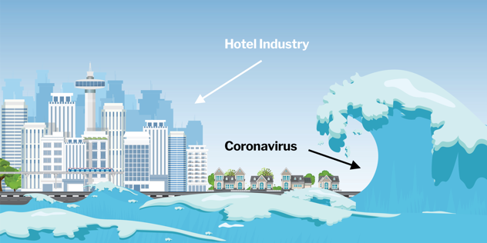
CONTEXT
PROBLEM IDENTIFICATION
DATA WRANGLING
EDA
PRE-PROCESSING
MODELING
DOCUMENTATION
The COVID-19 pandemic - a major global events of our times.
It affected people as well as businesses.
Some businesses suffered disproportionate damage.
Hotels must recover fast.

Slide 4

Problem statement
PROBLEM IDENTIFICATION
DATA WRANGLING
EDA
PRE-PROCESSING
MODELING
DOCUMENTATION
Why are booking cancellations a big issue?
Post COVID-19 average hotels booking cancellations rate was at 40%
One of the main inputs in the process of Targeted Marketing should be Cancellations Predictions.
Customers are as well affected by the high cancellations rate.
This Photo by Unknown Author is licensed under CC BY

Slide 5
PROBLEM IDENTIFICATION
DATA WRANGLING
EDA
PRE-PROCESSING
MODELING
DOCUMENTATION
Data Collection and Organization
The data was downloaded from ScienceDirect.
It contains more than 100,000 booking records from 2 hotels in Portugal.
The period covered was between 1st of July of 2015 and the 31st of August 2017
We started with a total of 32 features containing information such as: arrival date, number of adults, children or babies, if they are previous guests, how many prior cancellations they had and other.

Slide 6
PROBLEM IDENTIFICATION
DATA WRANGLING
EDA
PRE-PROCESSING
MODELING
DOCUMENTATION
Initial Numeric data exploration
To clean data, we need to explore data.
We explored the numerical data distributions and outliers, and here are some findings:
an average 37.04% cancellation rate for the 2 hotels
that all the top 10 bookings with the highest number of adults were canceled
A single outlier was identified as entry error and was removed from the dataset - a booking with an extremely high ADR value.

Slide 7
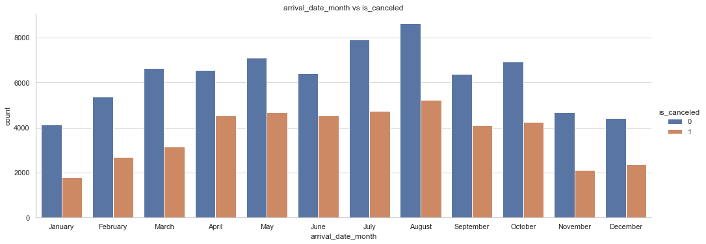
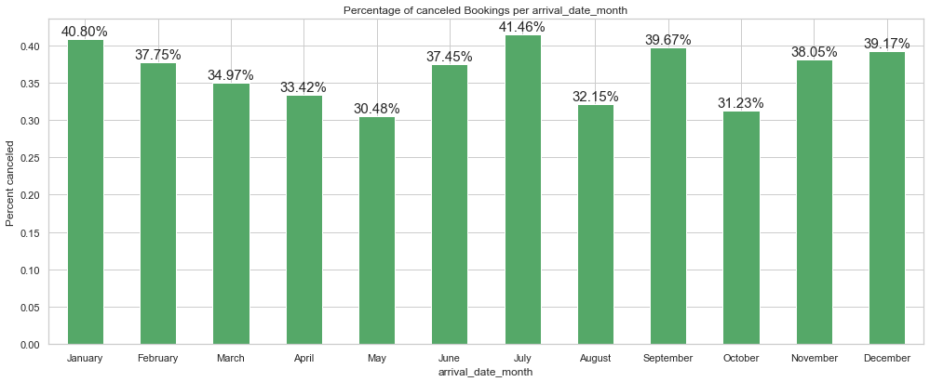
PROBLEM IDENTIFICATION
DATA WRANGLING
EDA
PRE-PROCESSING
MODELING
DOCUMENTATION
Initial Categorical data Exploration
Out prediction target feature was the binomial feature is_canceled.
Conducted Data Visualizations of categorical features versus our target feature.
One interesting finding was the months distribution, and another was regarding the Deposit type feature
Completed by cleaning missing values and saving data.

Slide 8
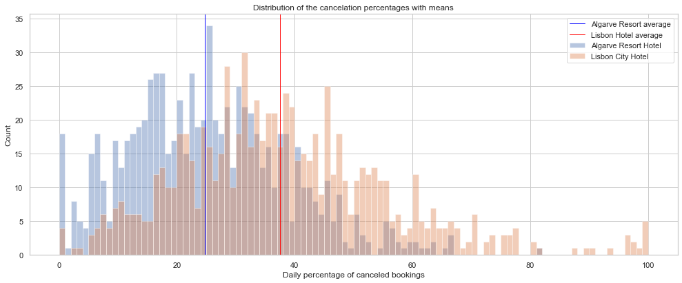
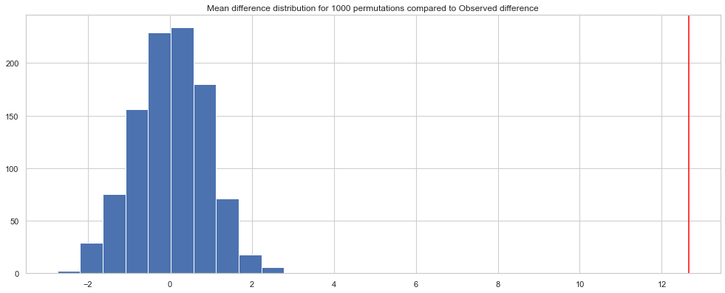
PROBLEM IDENTIFICATION
DATA WRANGLING
EDA
PRE-PROCESSING
MODELING
DOCUMENTATION
Hypothesis testing
“EDA approach is precisely that - an approach - not a set of techniques, but an attitude/philosophy about how a data analysis should be carried out.” e-Handbook of Statistical Methods
How different are the two hotel bookings cancellations?
We created the daily cancellations rates and used them to see the two hotels’ distributions
Non-parametric test with 1000 permutations.

Slide 9
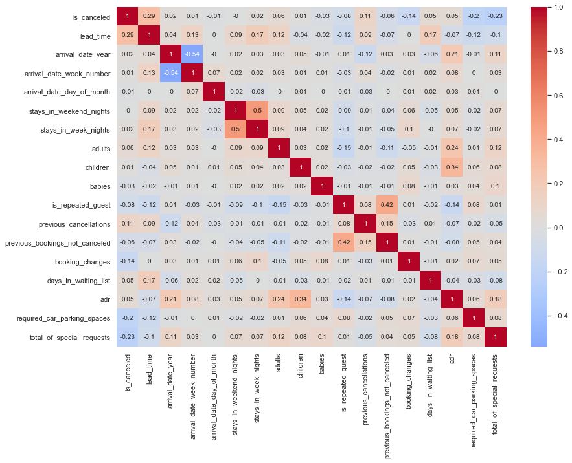
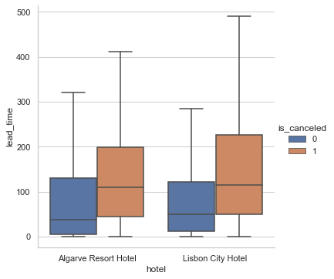
PROBLEM IDENTIFICATION
DATA WRANGLING
EDA
PRE-PROCESSING
MODELING
DOCUMENTATION
Feature analysis
Heatmap to visualize all correlations from numerical features
Starting from this we continued with bivariate EDA and multivariate EDA
High correlation between
Is_canceled and lead_time.

Slide 10
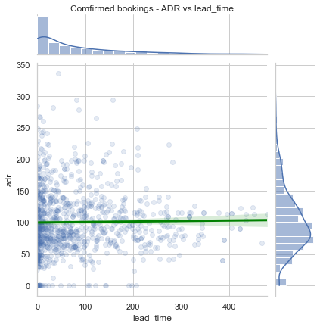
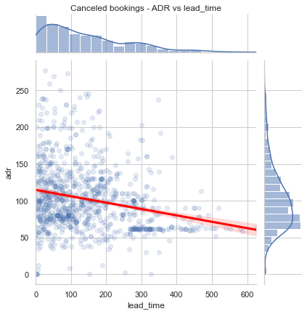
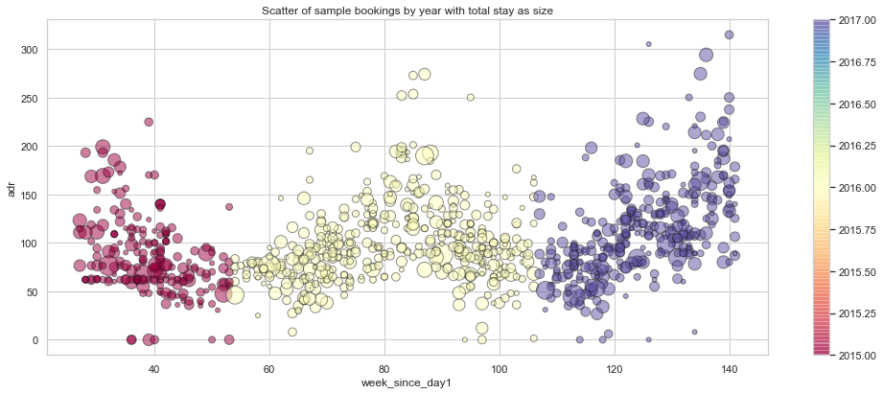
PROBLEM IDENTIFICATION
DATA WRANGLING
EDA
PRE-PROCESSING
MODELING
DOCUMENTATION
Feature analysis
Analyzed correlation between ADR(average daily rate) and lead_time on canceled and confirmed bookings subsets.
Plotted correlations between week number, ADR and length of stay.

Slide 11
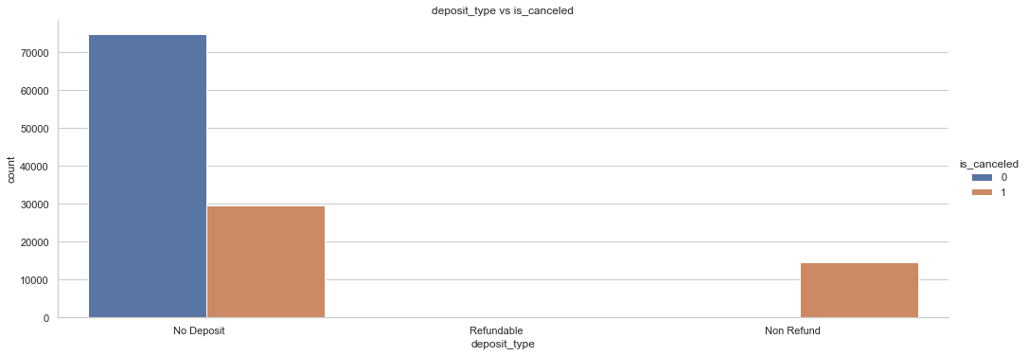
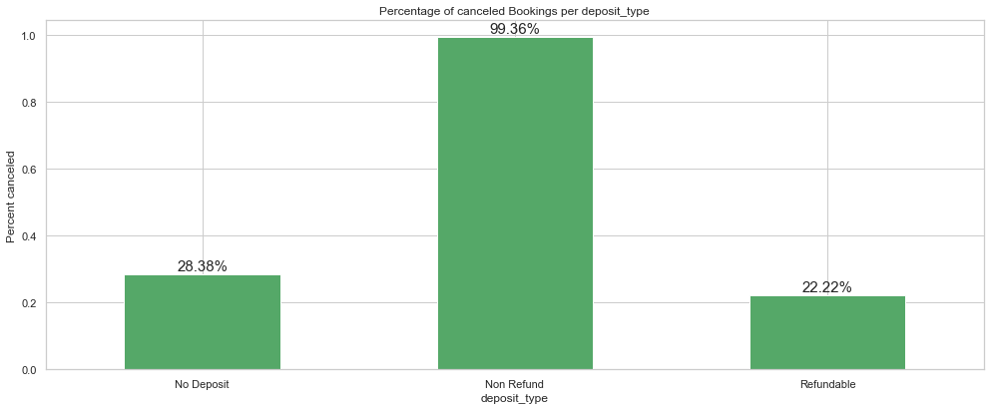
PROBLEM IDENTIFICATION
DATA WRANGLING
EDA
PRE-PROCESSING
MODELING
DOCUMENTATION
Non-refundable deposit
Issue identified in Data Wrangling section.
14,586 customers did a non-refundable deposit
“Non Refund – a deposit was made in the value of the total stay cost”- Source Data Description
Analyzed direct feature correlation
Analyzed the difference of correlations between the subset of non-refundable deposits and the whole data.

Slide 12
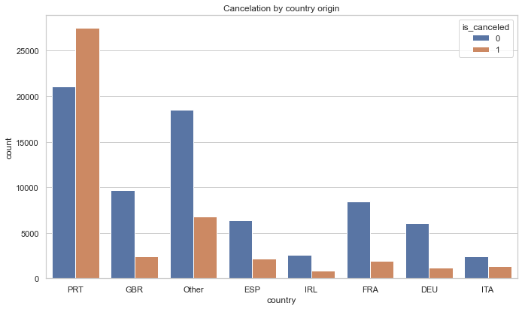
PROBLEM IDENTIFICATION
DATA WRANGLING
EDA
PRE-PROCESSING
MODELING
DOCUMENTATION
Data Leakage analysis
Data was collected with a “timestamp relative to the day prior to arrival date” - Source Data Description
“It is also common for hotels not to know the correct nationality of the customer until the moment of check-in” - Source Data Description
While more features were analyzed, we considered just the
country origin to be source of data leakage and removed it.
Regarding possible Data Leakage from Train to Validation
Sample, we made sure to make the train_test_split and fit
Any feature engineering methods just on the training set.

Slide 13
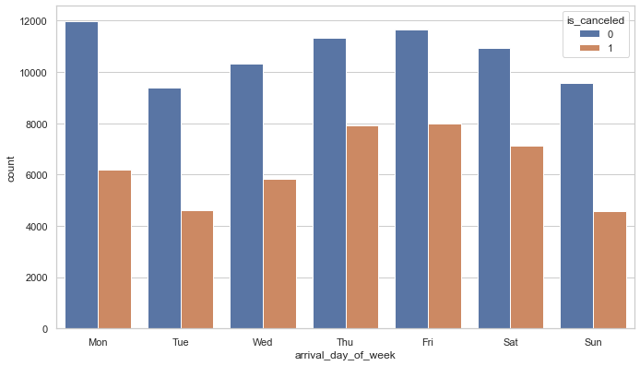
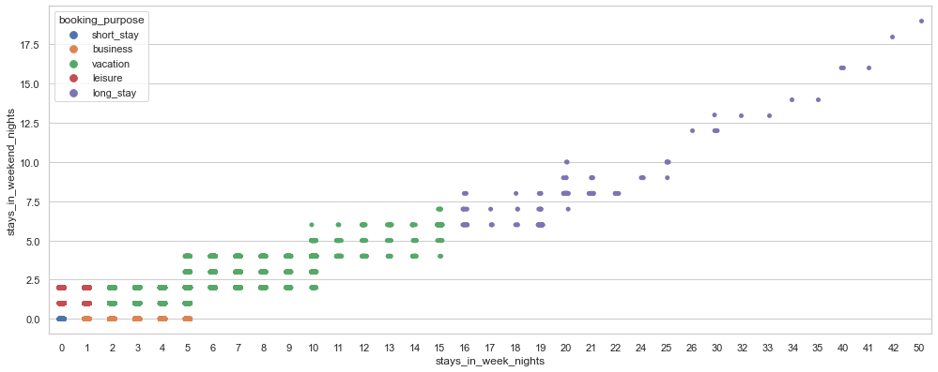
PROBLEM IDENTIFICATION
DATA WRANGLING
EDA
PRE-PROCESSING
MODELING
DOCUMENTATION
Feature engineering
Using the arrival date, we created a feature containing arrival’s day of the week.
Using the number of weekdays and weekend days booked we clustered they stays in 5 categories based on duration, creating
booking_purpose feature
Using the received room type and assigned room
type we created the binomial feature
received_different_room.

Slide 14
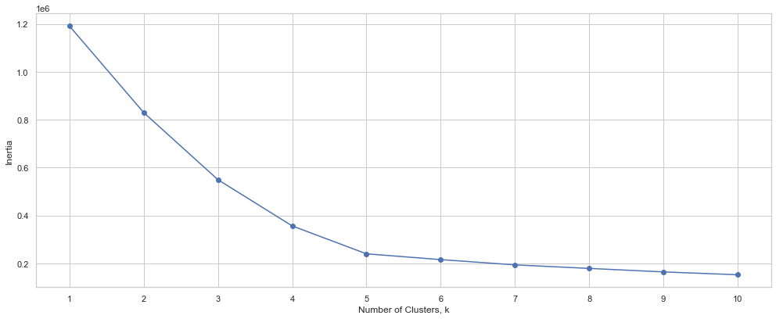
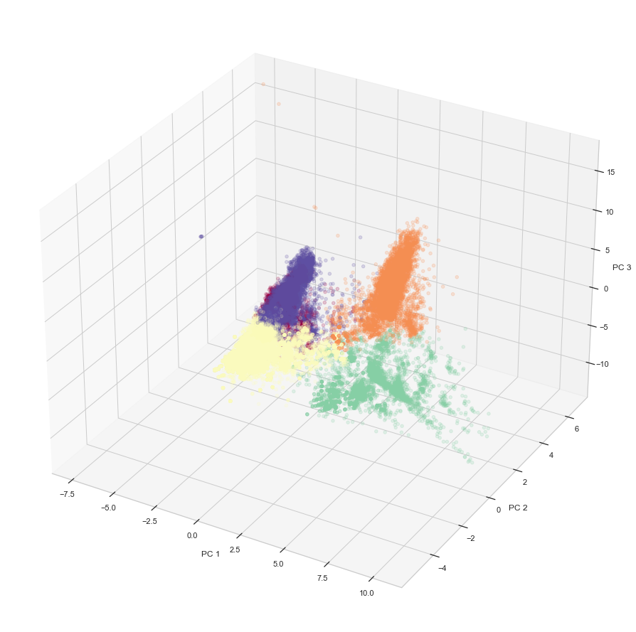
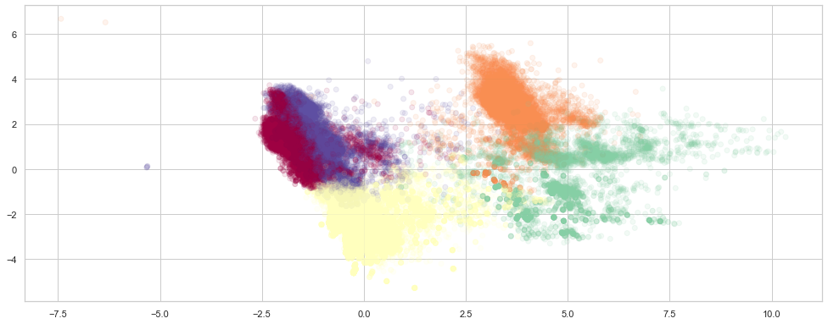
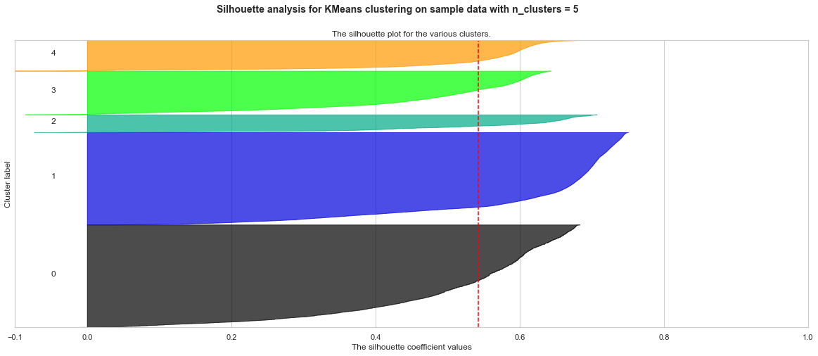
PROBLEM IDENTIFICATION
DATA WRANGLING
EDA
PRE-PROCESSING
MODELING
DOCUMENTATION
Customer Segmentation – Unsupervised Learning
For the Unsupervised Learning Clustering we used just 21 features
Compared how Kmeans model performed before and after Scalling and PCA transformation
Best model with a silhouette_score of 0.54 returned 5 classes(with Scaler and 4PCA features)

Slide 15
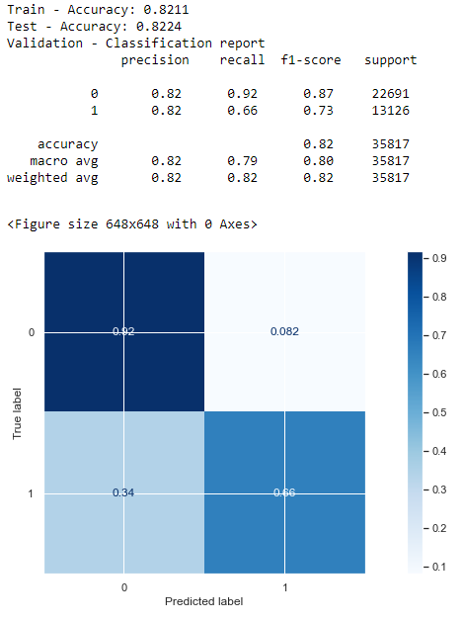
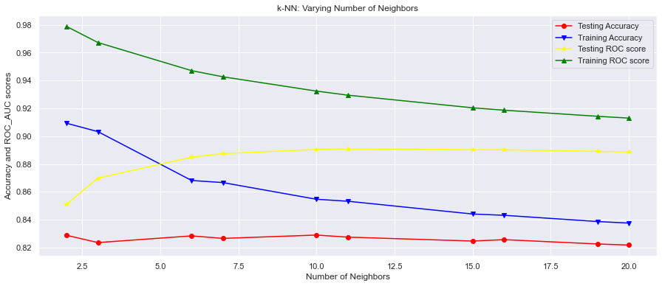
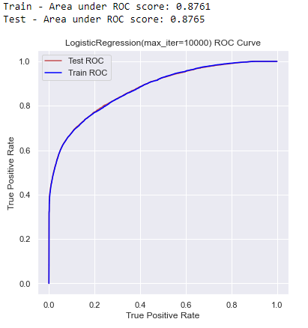
PROBLEM IDENTIFICATION
DATA WRANGLING
EDA
PRE-PROCESSING
MODELING
DOCUMENTATION
Metrics and Supervised Learning
Metrics used: Accuracy and ROC’s area under the curve for ranking and additional condusion matrix and classification report fro visualization. We used a DataFrame to save the metrics.
The models used are: LogisticRegression, KNN, Random Forest Tree and Catboost.
Other Tools used:
Hyperparameter Tuning Using GridsearchCV and RandomSearchCV
Regularization using Lasso or
Ridge
Feature Decomposition using PCA
Feature Selection using
permutation_importance and
feature_importances_

Slide 16
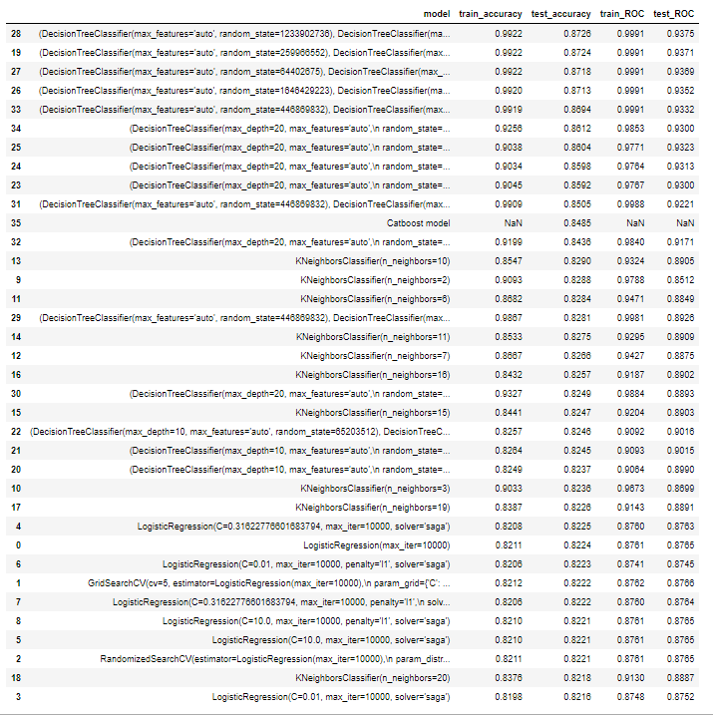
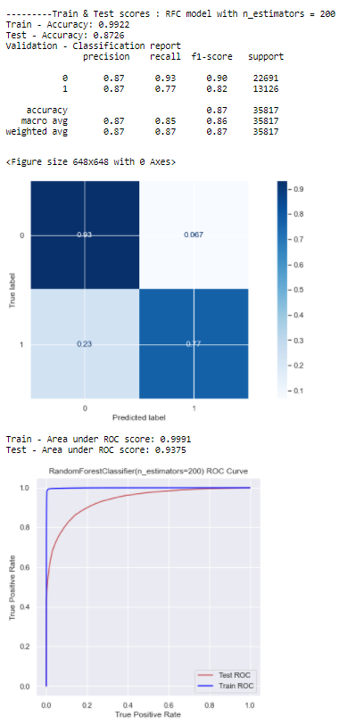
PROBLEM IDENTIFICATION
DATA WRANGLING
EDA
PRE-PROCESSING
MODELING
DOCUMENTATION
ScoreS ranking and model selection
Best model – RFT with n_estimators = 200
Accuracy: 0.8726
roc_auc score: 0.9375
Second best model: Catboost
Accuracy: 0.8485
Third best: KNN(10 neigbors)
Accuracy: 0.8290
roc_auc score: 0.9324
Fourth best: LogReg(c=0.31)
Accuracy: 0.8225
roc_auc score: 0.8763

Slide 17
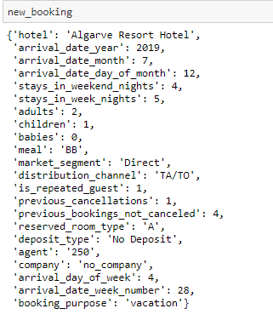
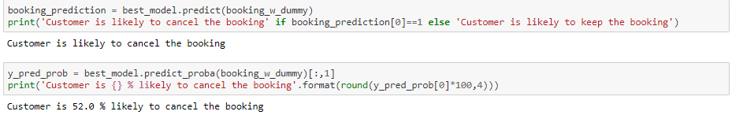
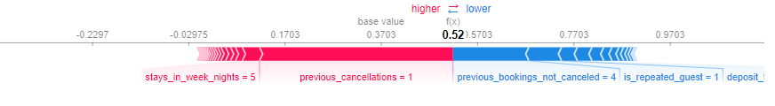
PROBLEM IDENTIFICATION
DATA WRANGLING
EDA
PRE-PROCESSING
MODELING
DOCUMENTATION
Recommendations
model implementation and usability
One aspect had under consideration was to have the prediction as fast as possible.
Identified 2 possible models that can be deployed:
Front Desk Cancellations Percentage model.
Monthly Cancellations Assessment.
Manually created a new random booking and calculated the prediction.
The predicted probability is 0.52, so a
52% cancellation percentage.

Slide 18
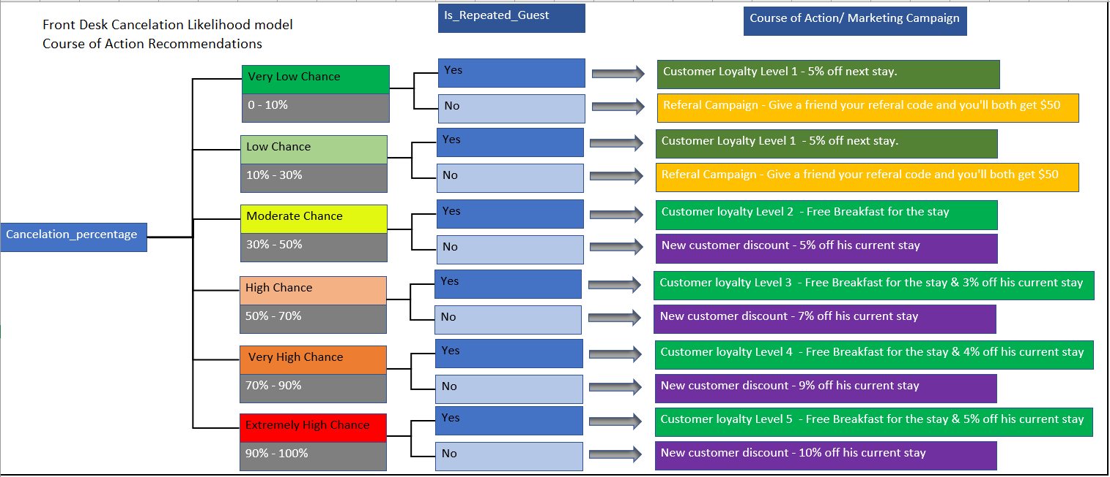
PROBLEM IDENTIFICATION
DATA WRANGLING
EDA
PRE-PROCESSING
MODELING
DOCUMENTATION
Recommendations
Business Course of Action using model

Slide 19

PROBLEM IDENTIFICATION
DATA WRANGLING
EDA
PRE-PROCESSING
MODELING
DOCUMENTATION
Future work
Are 99% of the customers with non-refundable full pay really canceling their booking?
Further Supervised Learning modeling using other Classifiers.
Create better user interactivity for adding a new booking.
After implementing the proposed Marketing Campaigns,
we can gather data about the effectiveness of these
Campaigns.
Then we can create other Machine Learning models
that can predict what types of Marketing Campaigns
we should use to target different groups of customers.

Slide 20

Thank you!
Questions?

